Slide 1


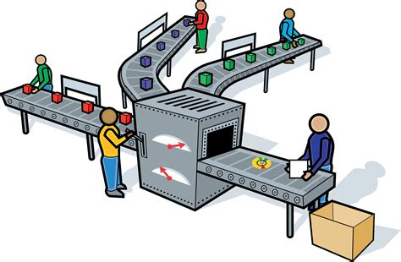












Slide 2
23 Sectors of the Economy - Simplicable

Slide 3




Construction Sector
Manufacturing Sector
Retail Sector
Transportation Sector
Agriculture Sector
Financial Sector
BANK
Utility Sector

